Slide 1
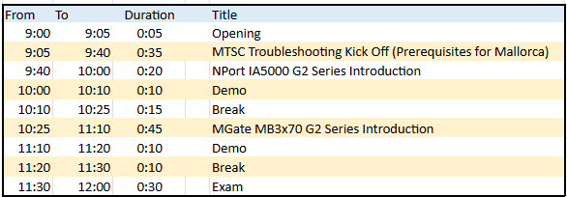
AGENDA
Day: Feb 5^{th, 2026}

Slide 2
2026 MTSC Troubleshooting Event
Christian Gromeier, Hans Igeler and Jean-Marc Olivier
Feb. 5th, 2026

Slide 3
Agenda
Venue
Transport
Organization
MTSC Agenda
What to Prepare?
Where to find information?

Slide 4

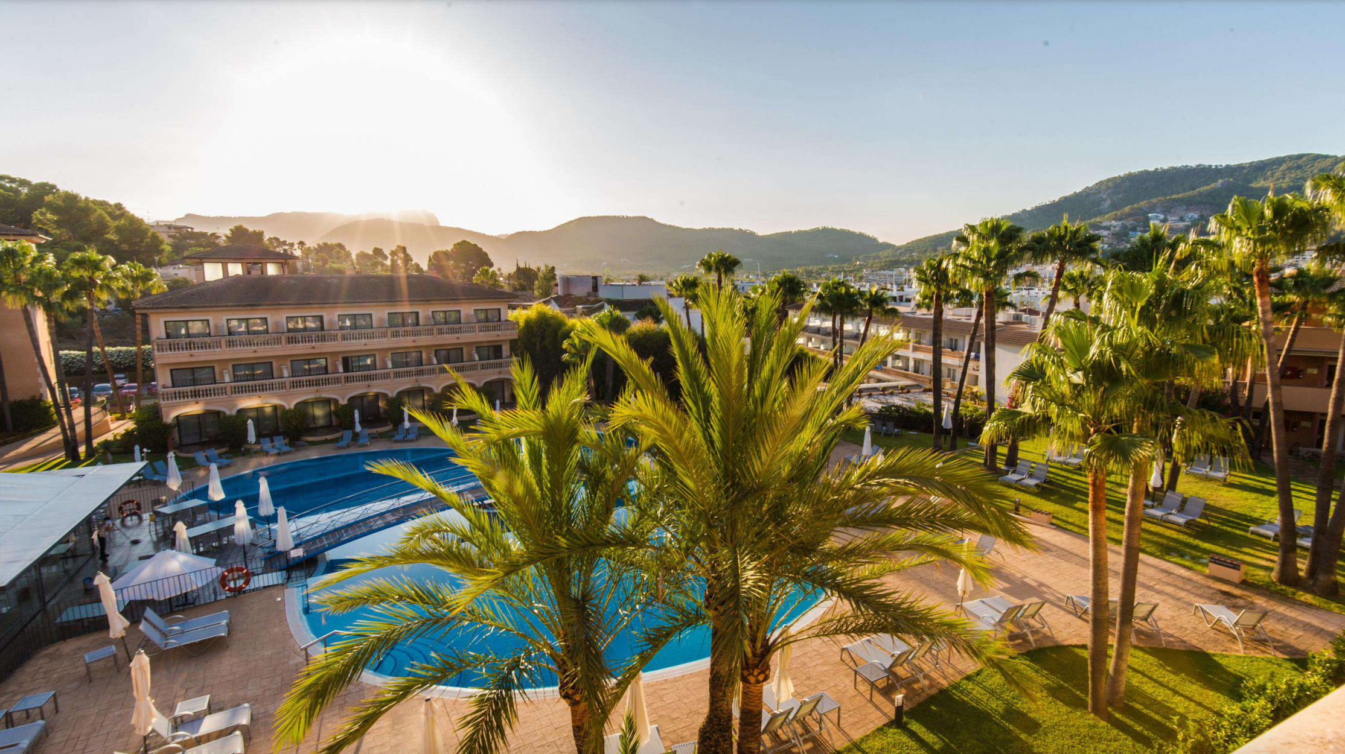
MTSC 2026 - LOCATION REVEAL
MTSC 2026
Mallorca, Spain
March 9 - 13, 2026
Hotel
Mon Port Hotel & Spa
Port d`Andratx
Location
Cala d'Egos, Finca la Noria
07157 - Port D'andratx - Mallorca
Notes:
Airport is just 35 minutes away; on a very easy road.
10 minutes to Santa Ponça, Calvià Beach.
15 minutes to Puerto Portals
5 minutes to Cala Llamp.

Slide 5
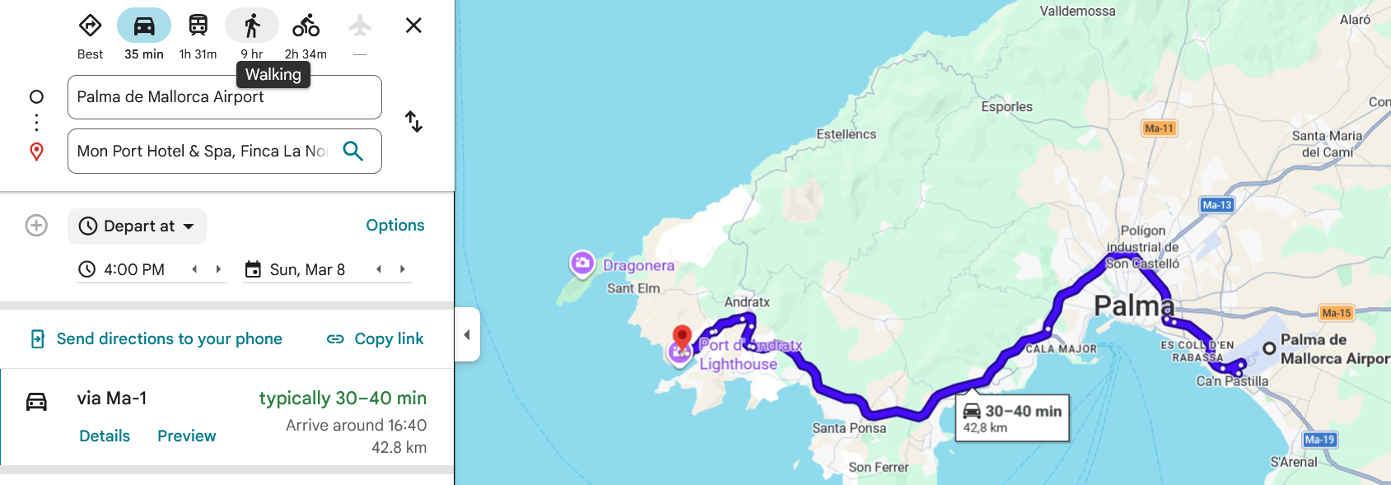
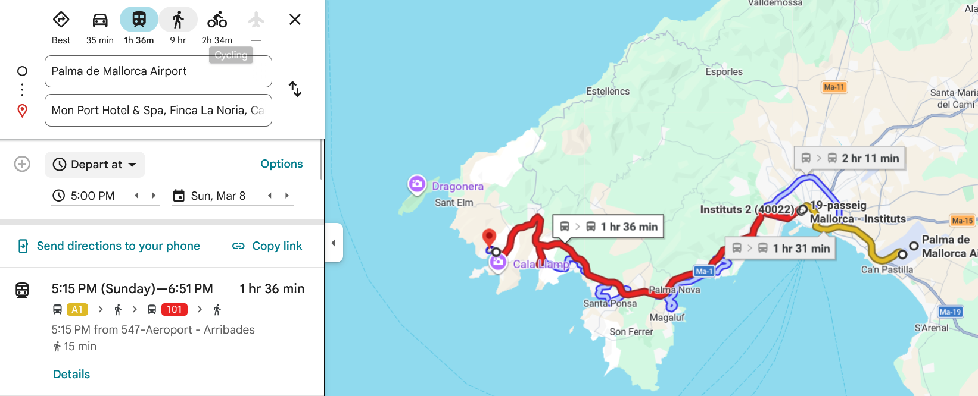
2026 MTSC TRANSPORTATION
Transport From/To Airport
by Taxi
ca. 42.8km
Time: 35min
Expected price: 55 to 70 Eur
by Rental Car
ca. 42.8km
Time: 35min
by Bus,
Line A1+101
Time: 1h36

Slide 6
2026 MTSC ORGANIZATION
Organisational
2 Day Event (includes two dinners)
Farewell dinner on the second day
Awards presented during the farewell dinner
sport shoes and clothing for 2nd day
Content
Minimal theory, primarily practical exercises
Hands-on approach following step-by-step instructions
Flipped classroom model → preparation required
Prerequisites provided
Table coaches available
MTSC material not disclosed beforehand
Other
Expect participant to come to MTC-IES
Online exam, counting for MTSC certification, registration for new bees
Results sent via email
Printed certificates available upon request
No printed materials; only soft copies provided
No USB stick → materials will be uploaded
to our landing page

Slide 7
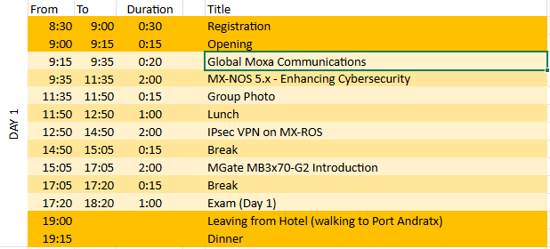
AGENDA
Day 1: March 9 and March 12

Slide 8
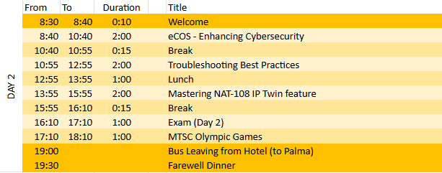
AGENDA
Day 2: March 10 and March 13

Slide 9
DAY 1

Slide 10
2026 MTSC
What to Prepare before coming – Day 1
MXNOS 5.x – Enhancing Cybersecurity
Material required.
PC with Windows (10/11)* and Chrome or Firefox or MS Edge.
Pre-work material / assignments for participants:
Understanding of Rsyslog server (https://www.rsyslog.com/doc/index.html)
Mx-NOS V5.x User Manual (https://cdn-cms-frontdoor-dfc8ebanh6bkb3hs.a02.azurefd.net/getmedia/0b12048d-c0fb-4625-9389-fb29a84f88fb/moxa-managed-switch-mx-nos-v5.x-command-line-interface-user-manual-manual-v1.1.pdf)
Review MACsec material from MTSC Product session.(https://moxaeurope.com/MTSC/2025/Q3/MTSC-2025_Q3_Handout.zip)

Slide 11
2026 MTSC
What to Prepare before coming – Day 1
IPsec VPN on MX-ROS with EDR-G9004
Pre-work material / assignments for participants:
Have a working installation of Wireshark.
Familiarize yourself with the MX-ROS WebGUI (general configuration, as well as IPsec) through hands-on practice or User Manual: https://cdn-cms-frontdoor-dfc8ebanh6bkb3hs.a02.azurefd.net/getmedia/b62b1578-d455-4647-8eac-a2a59723e517/moxa-manual-for-mx-ros-v3-manual-v1.14.pdf, IPsec is pages 571-596.
Make sure you have administrative rights on your laptop to change IP address or other configuration settings.

Slide 12
2026 MTSC
What to Prepare before coming – Day 1
Mgate-MB3x70-G2 Introduction
Pre-work material / assignments for participants:
Review MTSC Products Feb/2026
Understand basics of Modbus RTU, Modbus TCP Protocols
Complete MTC-CON-100 Learning path in MTC e-Learning
https://moxa.litmos.com.au/admin/learningPaths/64872/LearningPathContent
(We grant access by latest feb 6th)
Know how to configure MGate MB3x70-G2
Review the MGate G2 New Web GUI video
https://www.moxa.com/en/videos/mgate-g2-quick-install
UM, Configuration in Transparent mode (Page 27++)
UM, Configuration in Agent mode (Page 29++)
Download User Manual from Product page:
https://www.moxa.com/en/products/industrial-edge-connectivity/protocol-gateways/modbus-tcp-gateways/mgate-mb3170-g2-mb3270-g2-mb3470-g2-series

Slide 13
DAY 2

Slide 14
2026 MTSC
What to Prepare before coming – Day 1
eCOS – Enhancing cybersecurity
Pre-work material / assignments for participants:
Understand basics of ethernet technology, including BPDU, Multicast packets.
Review the User Manual and Command Line Interface Manual for EDS-510E
Understand QoS and security concepts
Be able (and have the necessary admin rights) to configure EDS-510E settings on own laptop.
Know how to use colasoft packet builder to send packets
Software:
PC with Windows 10/11 and Google Chrome, Firefox or MS Edge (Per participant).
PUTTY or other Terminal Emulator:
https://www.chiark.greenend.org.uk/~sgtatham/putty/latest.html
Wireshark installed Version 4.0.0 or later. download from here:
https://www.wireshark.org/download.html
Colasoft Packet Builder
Packet Builder for Network Engineer - Colasoft

Slide 15
2026 MTSC
What to Prepare before coming – Day 2
​Troubleshooting Best Practices: A Practical Case-Based Approach​
Participants Prerequisites
Understand the Distributor and Moxa Technical Support pyramid
Be familiar with Type 0 and Type 1 case handling
Understand Moxa industrial network topologies and redundancy concepts
Be comfortable facilitating discussion without teaching solutions

Slide 16






Moxa Europe Technical Support Network
Moxa
R & D
4. Product Team(PBG)
Level 4:
Level 3:
3. MEU Global TS (Taipei)
2. MEU Local FAE +
TS (Europe)
9
19
-----------------
Escalation
------------------------------
Moxa Pre & Post
Level 2:
FAE+TS+GTS
Moxa
Certified Distributor
38
Level 1:
Distributors
End Customer / Reseller / System Integrator / Key Account

Slide 17

Post-Sales Support
Technical Support Case Handling
1. Type 0 Case Support: Distributors are expected to handle Type 0 cases independently, providing necessary documentation and product certificates to customers.
2. Type 1 Case Support: Distributors should gather active information and troubleshoot for Type 1 cases. This involves detailed interaction with customers to collect necessary data, analyze issues, and perform preliminary troubleshooting steps under guidance.
17

Slide 18
2026 MTSC
What to Prepare before coming – Day 2
Mastering NAT 108 IP Twin Feature
Pre-work material / assignments for participants:
- Basic Knowledge of NAT (Reference: https://en.wikipedia.org/wiki/Network_address_translation -→ “Intro”/“Basic NAT”/“One-to-many-NAT”/”Implementation” section
- Basic Knowledge of NAT-108 GUI (Reference: https://cdn-cms-frontdoor-dfc8ebanh6bkb3hs.a02.azurefd.net/getmedia/b62b1578-d455-4647-8eac-a2a59723e517/moxa-manual-for-mx-ros-v3-manual-v1.14.pdf Chapter 2 / Chapter 3 Page 46 / Layer 2 Switching – VLAN Page 224-230 )
- Install software:
Web Browser (Chrome / Edge)
Recommended: Wireshark as general troubleshooting tool

Slide 19
Where to find the information?
Landing Page: https://moxaeurope.com
Agenda: https://moxaeurope.com/agenda.htm
MTSC Product Q1 / Q3 : https://moxaeurope.com/learning.htm
MTC E-Learning: https://moxa.litmos.com.au/
Questions to: mtsc.meu@moxa.com

Slide 20


Thank You
For further information, visit www.moxa.com

